Slide 1
KUBRA Storm Center Additional Map Layers | August 2023

Slide 2
Include Additional Map Data on Your Storm Center Outage Map.
Share the Data that Matters to Your Customers.
1
2
3
4
Aggregate data from multiple sources to provide additional information on Storm Center maps
Display information about hazards, planned work, wildfire advisories, gas outages, and more!
View detailed information about a specific feature by selecting it on the map
Provide a summary overview of the Additional Map Layer in the Overview Panel

Slide 3
Aggregate data from multiple sources to provide additional information on Storm Center maps
WMS
GIS
OMS
Seamlessly present data from various sources on Storm Center maps

Slide 4
Display information about hazards, planned work, gas outages, and more!
Additional Layers and Custom Layers are grouped in a new “Supplementary Layers” accordion

Slide 5
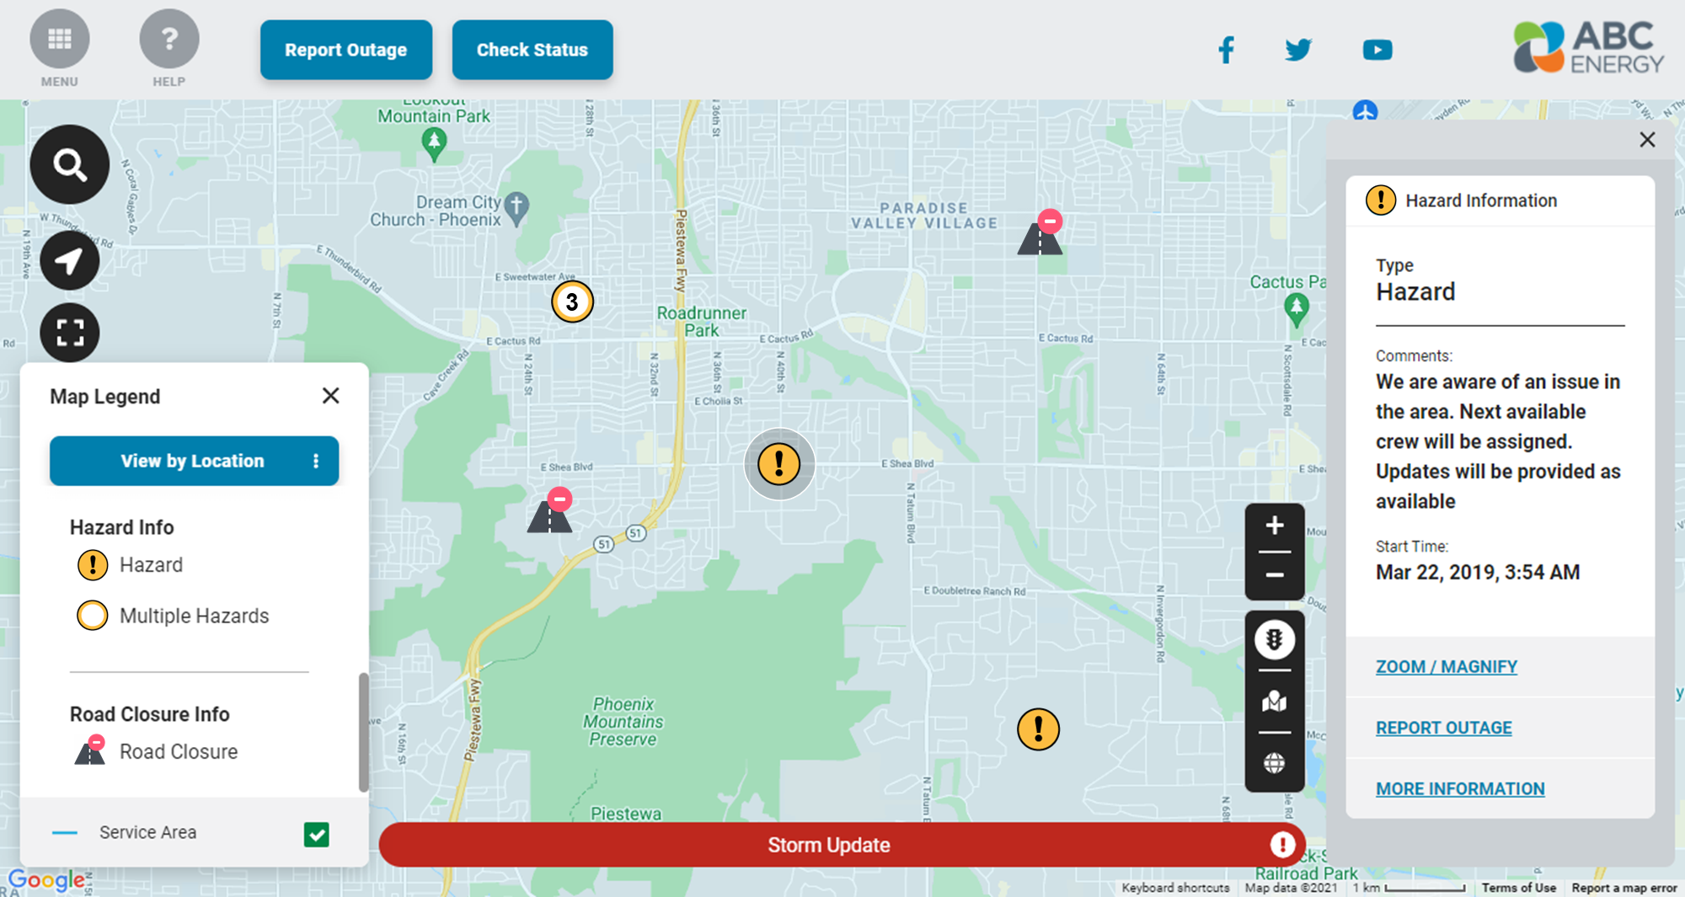
View detailed information about a specific feature by selecting it on the map
Click a specific icon on the map to get detailed updates in the information panel

Slide 6
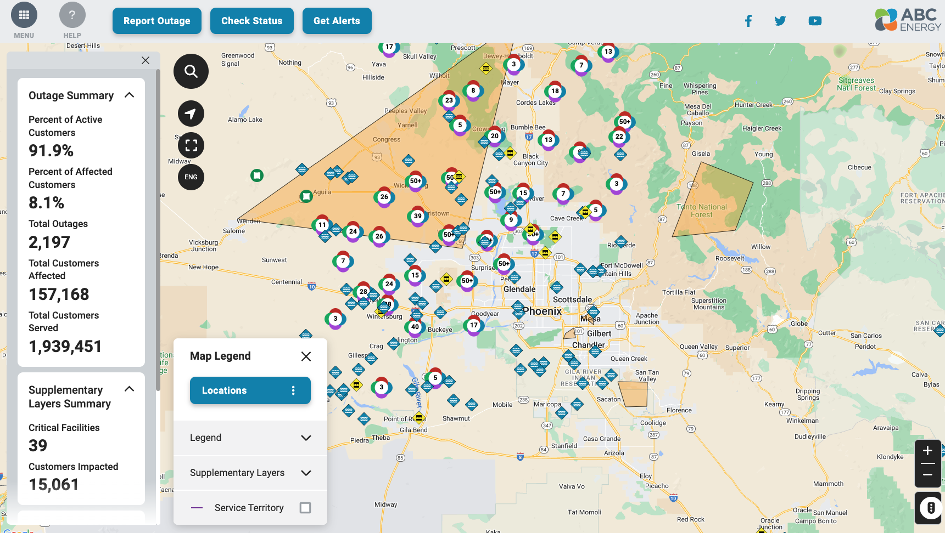
Provide a summary overview of the Additional Map Layer in the Overview Panel

Slide 7
Click here to learn more or request a demo

